Slide 1
6.3 Logistic Regression and the Softmax Cost

Slide 2
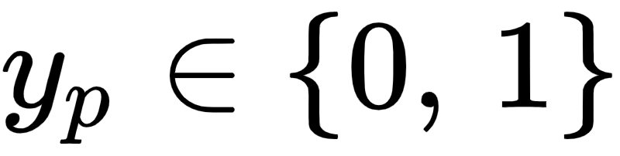
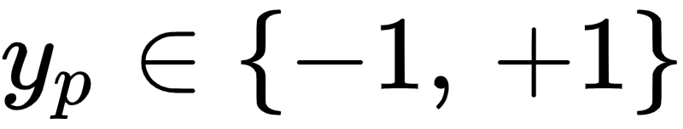
In the previous Section we saw how to derive logistic regression when employing label values
However as mentioned in the previous Section these label values are somewhat arbitrary, and one can just as easily derive logistic regression using label values
In this Section we do just this, resulting in new cost function called the *Softmax cost* for logistic regression.

Slide 3
While the Softmax differs in form from the Cross Entropy cost, it is in fact equivalent to it (as we will show as well).
This means that - practically speaking - one can use either the Softmax or Cross Entropy in practice to achieve equivalent results.
However - in principle - the Softmax cost is far more valuable helps unify the diverse set of motivations for linear two-class classification (as we will see in the Sections that follow).

Slide 4
Different labels, same story

Slide 5
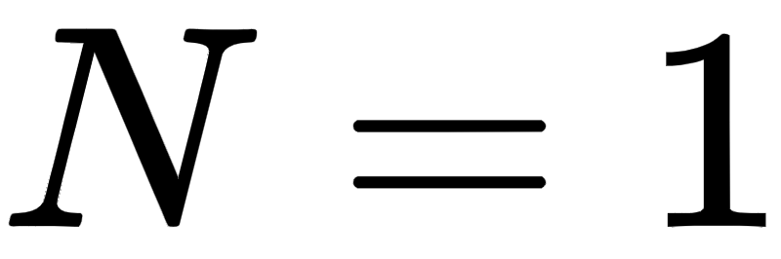
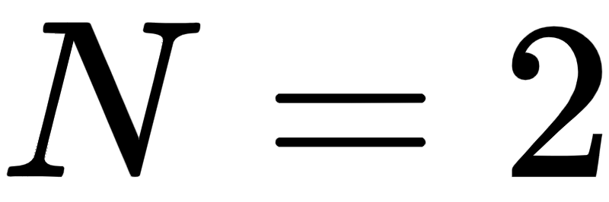
If we change the label values from to much of the story we saw unfold in the previously Section unfolds here as well, with only slight differences.
That is, instead of our data ideally sitting on a step function (with linear boundary) with lower / upper steps taking on the values 0 and 1 respectively, they take on values -1 and +1 as shown below for prototypical cases where (left panel) and (right panel).

Slide 6
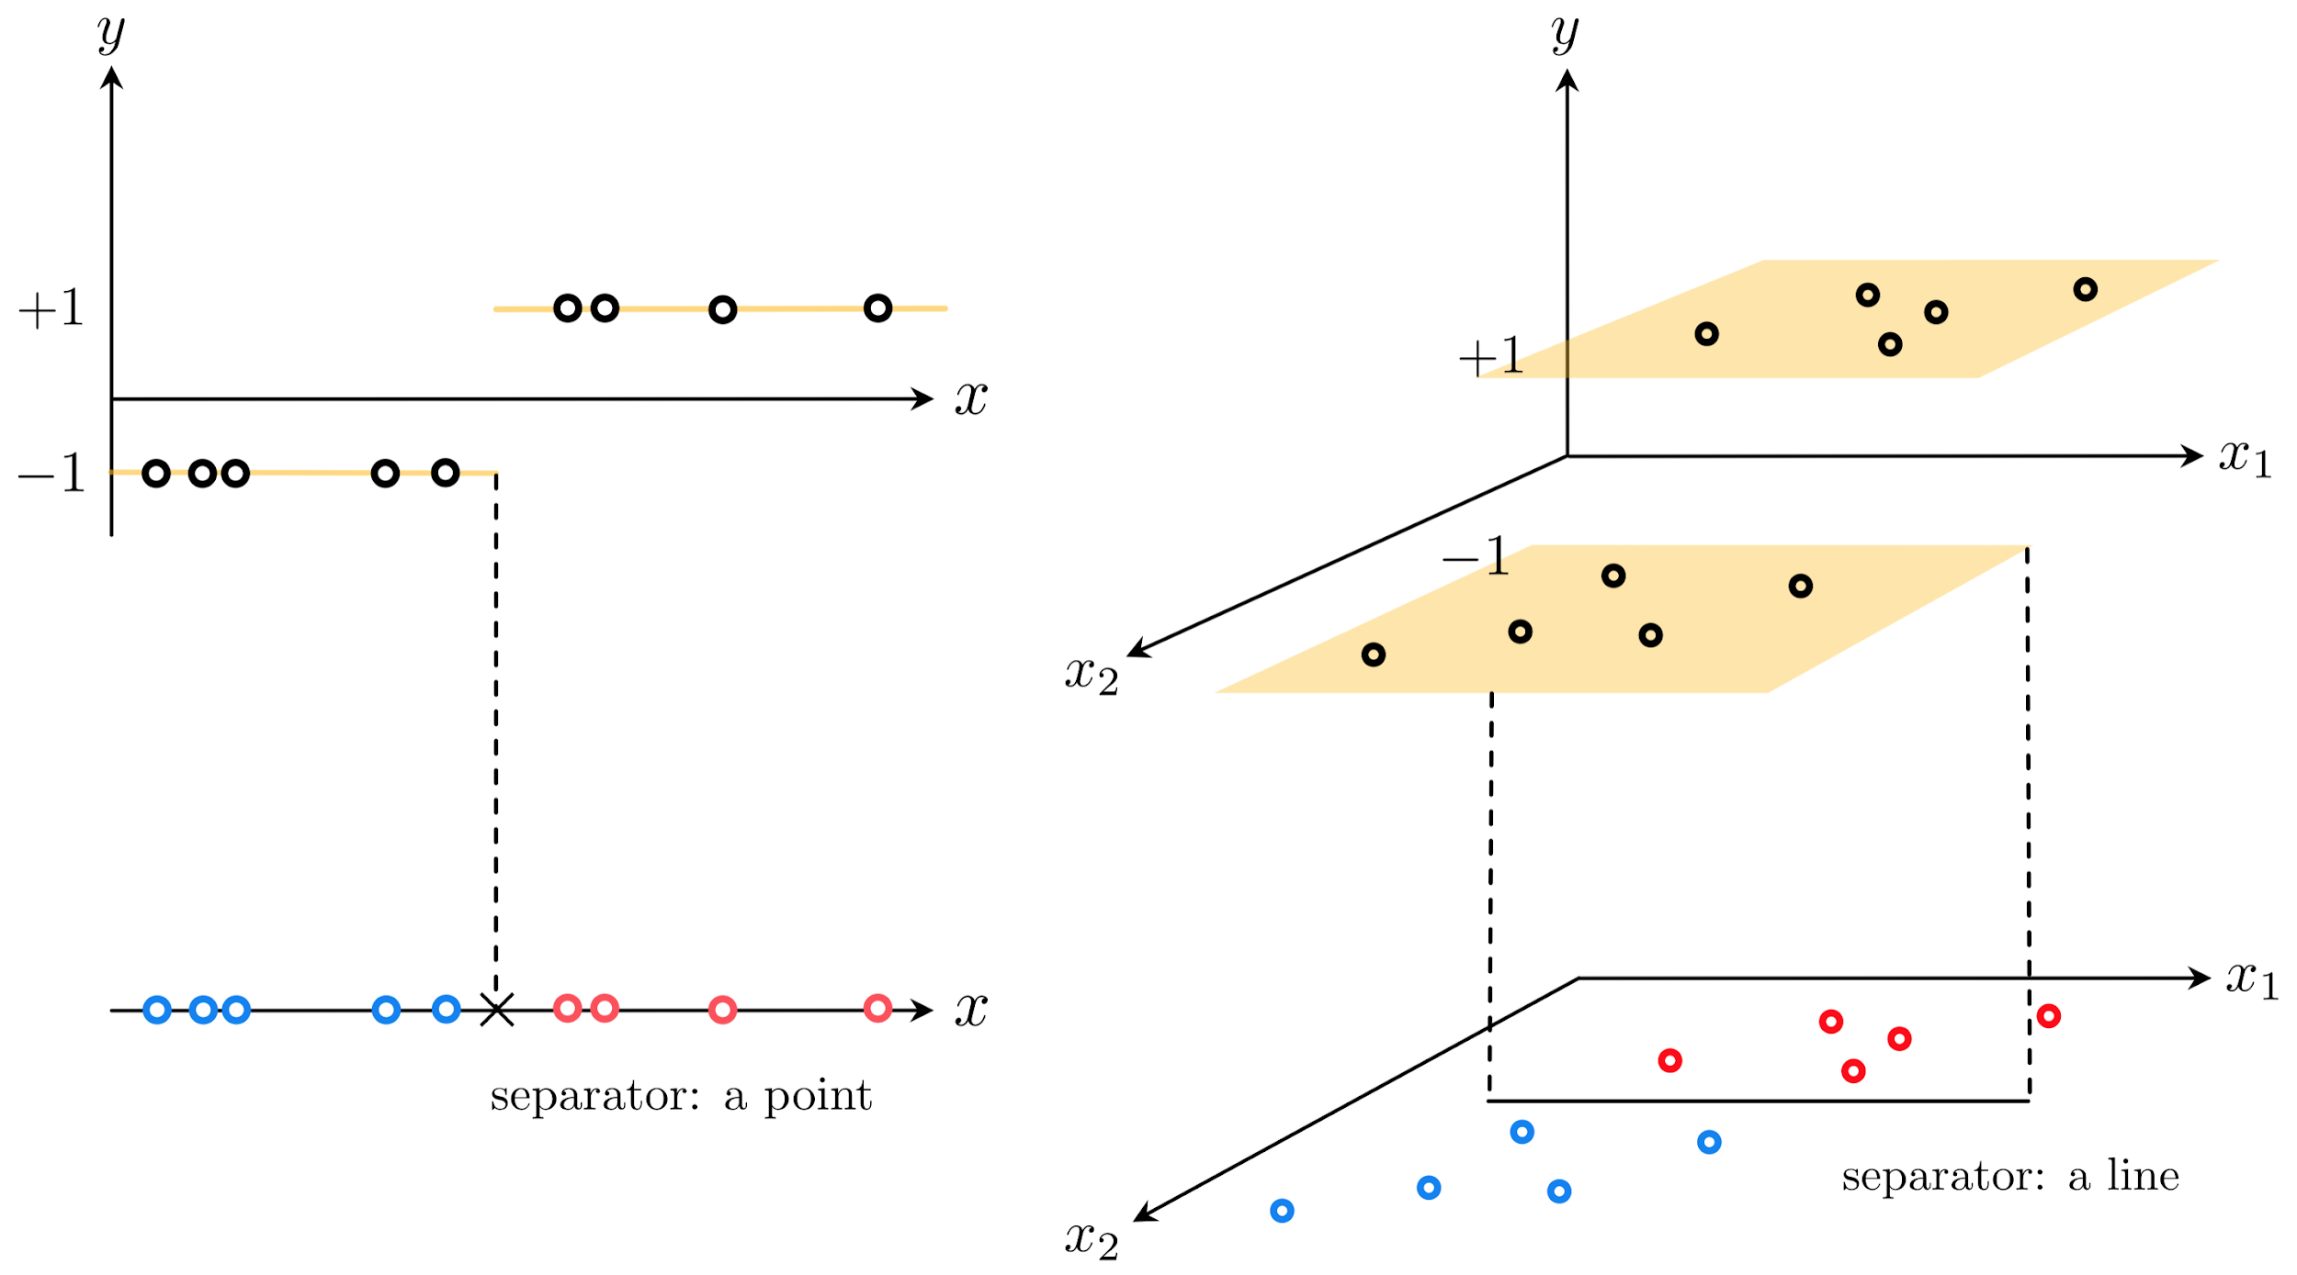

Slide 7
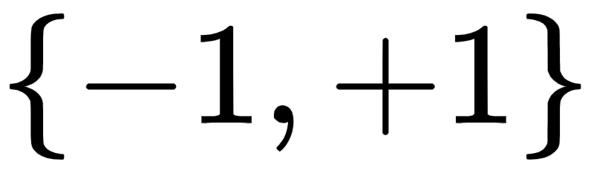
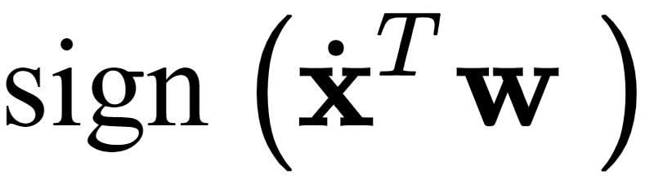
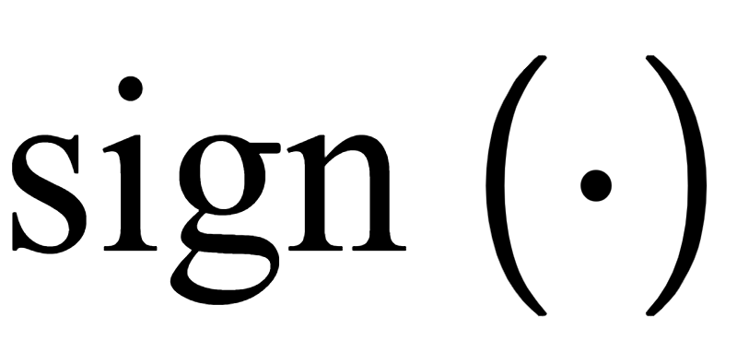
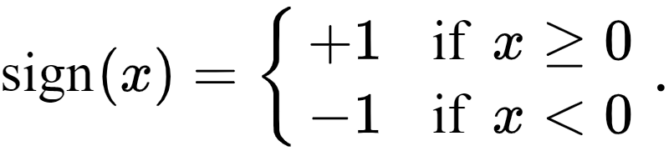
This step function taking on values , having a linear boundary between its bottom and top steps
Here we use our compact vector notation used in the previous Section and where the function is defined as

Slide 8
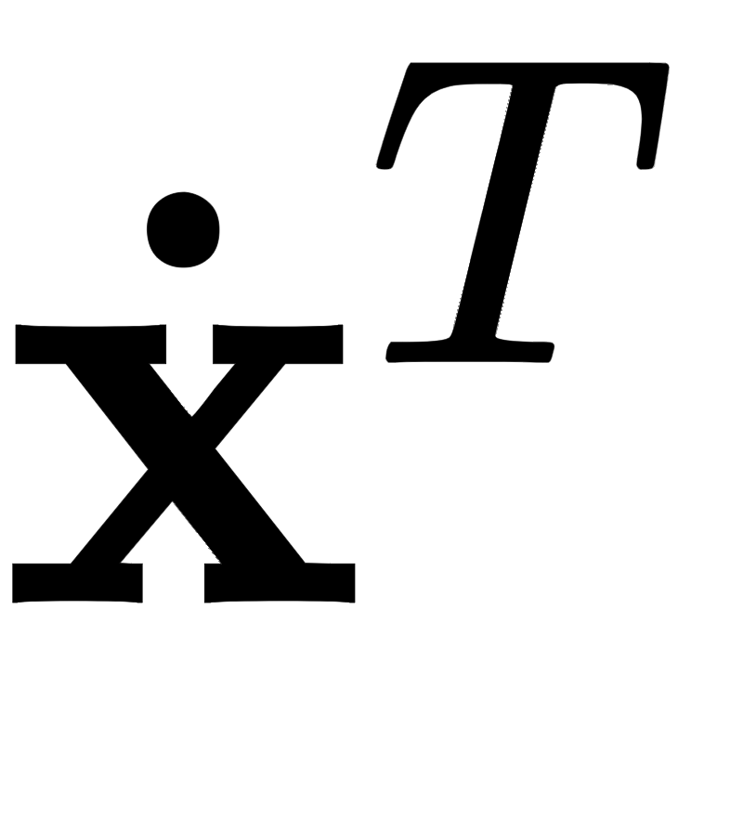
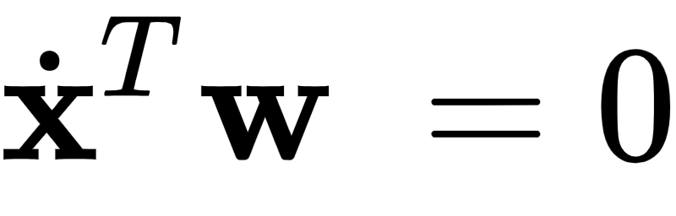

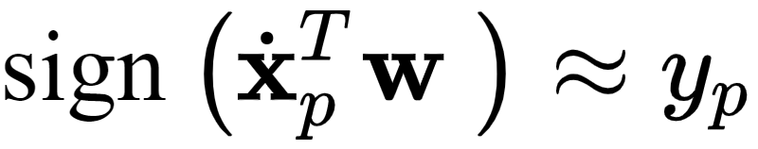
Notice in this case that our linear decision boundary lies along those where .
As with data using labels 0 and 1 (see Example 1 in the previous Section), linear regression would in general provide poor performance for data of this sort.
Because we want to tune the weights of our model so that our parameterized step function maps inputs to outputs correctly as

Slide 9

We could employ a Least Squares cost function involving directly as
However like the analagous Least Squares cost involving a step function in the previous Section, this is discontinuous, completely flat everywhere, and cannot be optimized easily.

Slide 10
The Tanh logistic sigmoid function

Slide 11

We could then look to replace the discrete with a smooth approximation.
A slightly re-scaled version of the sigmoid function - so that its values range between -1 and 1 instead of 0 and 1 - serves this purpose well.
This scaled version of the sigmoid is often called the hyperbolic tangent function and is written as

Slide 12
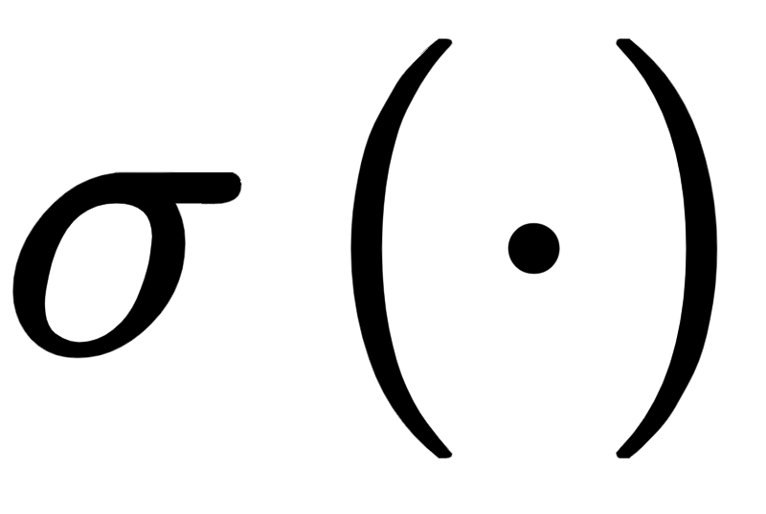
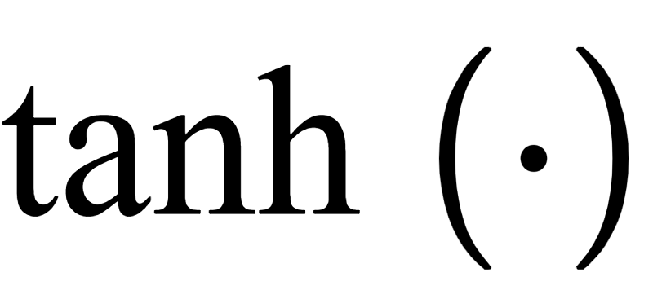
Given that the sigmoid function ranges smoothly between 0 and 1, it is easy to see why as defined above ranges smoothly between -1 and +1.
In the figure below we plot the tanh function (left panel), as well as several internally weighted versions of it (right panel).
As we can see in the figure, for the correct setting of internal weights the hyperbolic tangent function can be made to look arbitrarily similar to the sign function.

Slide 13
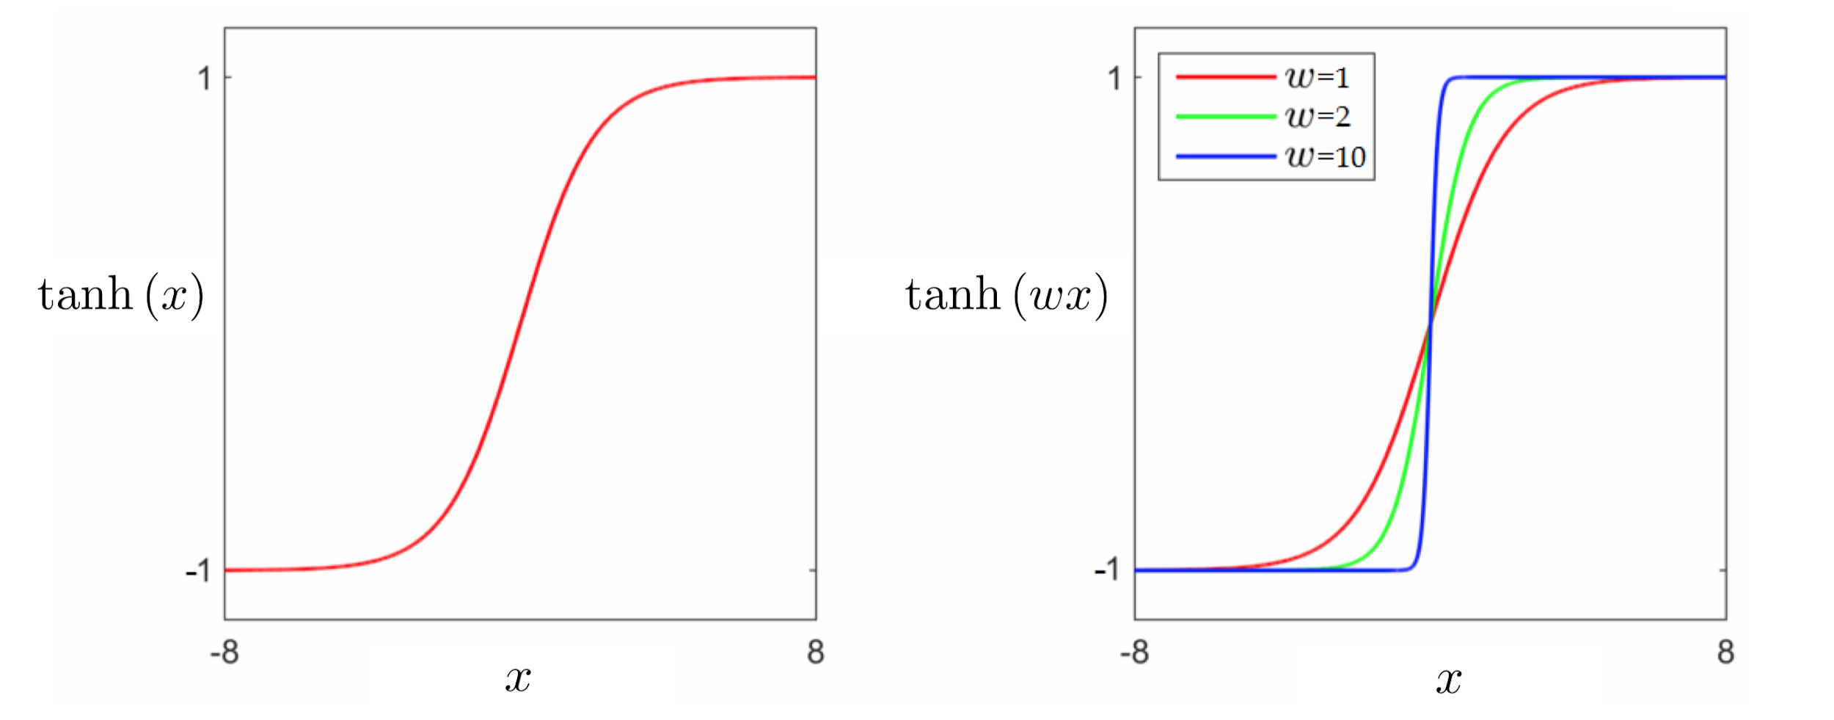

Slide 14
Logistic regression using the Least Squares cost

Slide 15
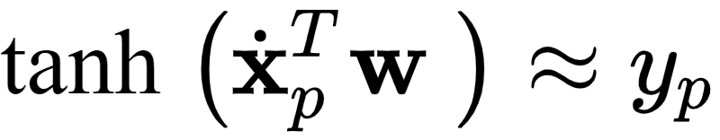
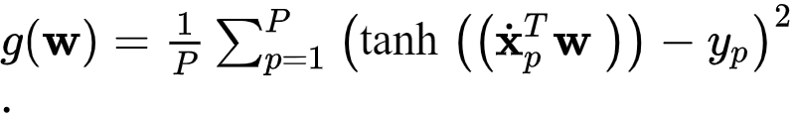
Replacing with gives a similar desired relationship (assuming ideal weights are known)
The analagous Least Squares cost function for recovering these weights
However this Least Squares cost (visualized below) is non-convex and has large flat regions that can impair optimization progress.

Slide 16
Example: Visualizing various cost functions on a toy dataset

Slide 17
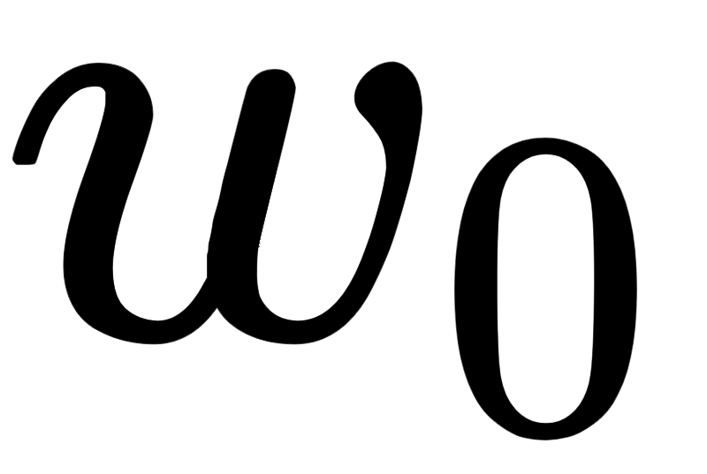
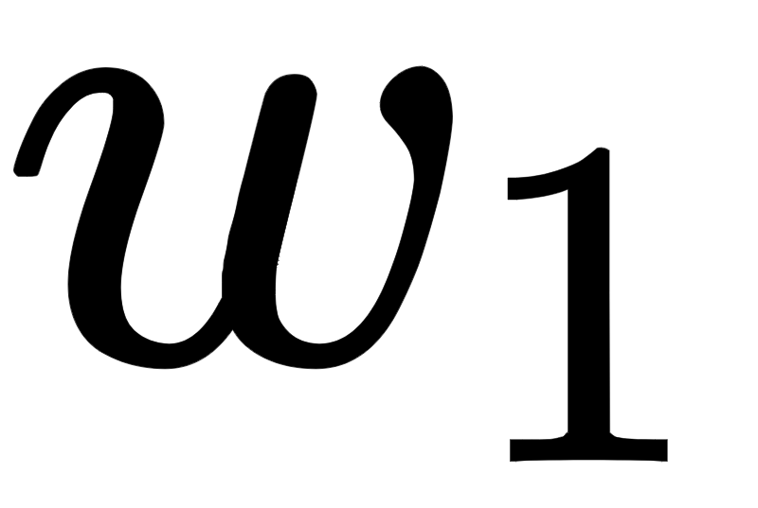
Below the Least Squares cost in equation for the dataset displayed in Example 1, over a wide range of values for and
This cost consists of discrete steps at many different levels, each one completely flat.
Because of this no local method can be used to minimize the counting cost.
In the middle and right panels we plot the surfaces of two related cost functions on the same dataset we discuss below.

Slide 18
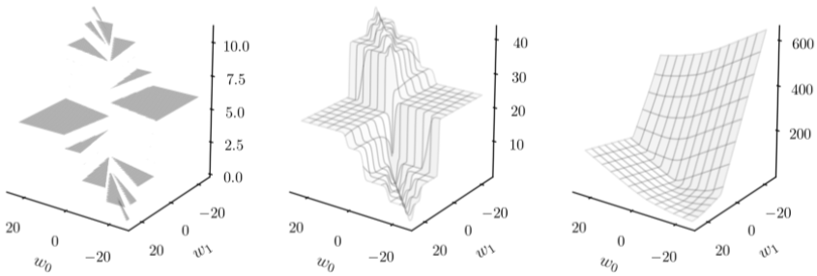

Slide 19
Logistic regression using the Softmax cost

Slide 20
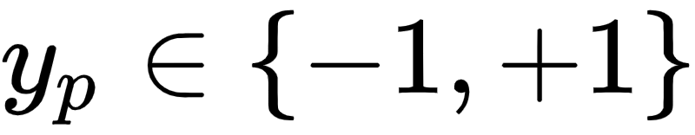
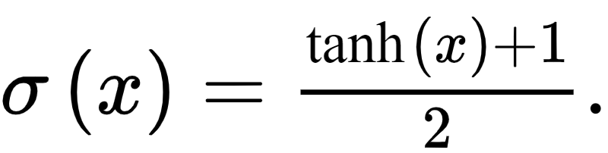
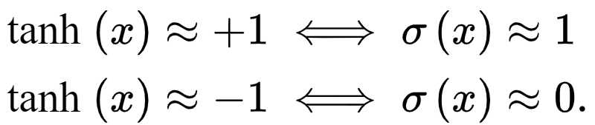
Because here we can construct a new cost function based on a penalty that more harshly penalizes error.
Note that if we rearrange the hyperbolic tangent function in terms of the sigmoid we have
Studying this relationship we can note, in particular, that

Slide 21
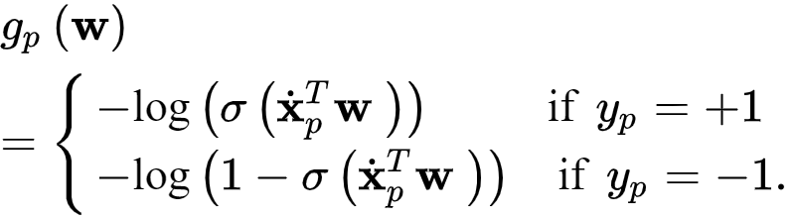
Because of this relationship we can employ point-wise cost function called the Log Error only our current label values

Slide 22
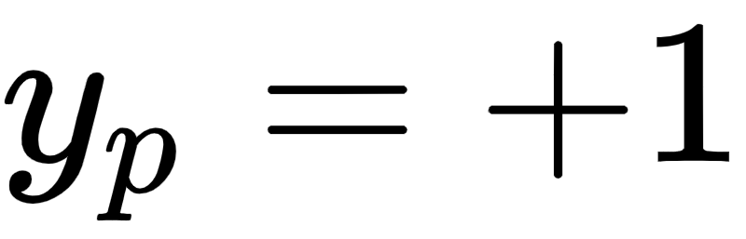
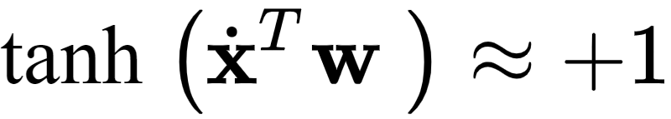

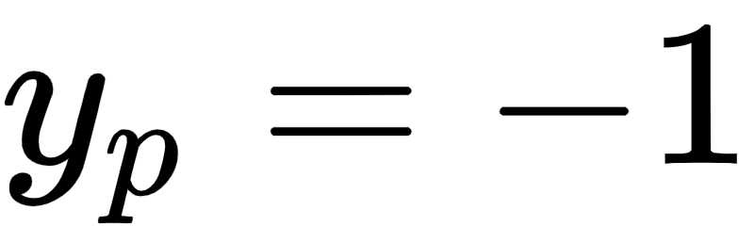
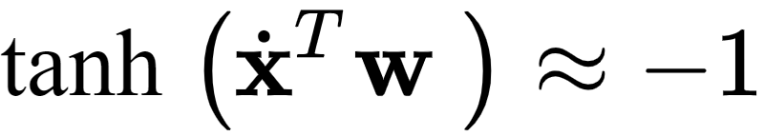
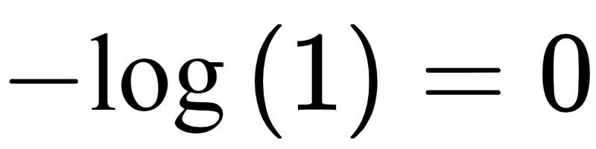
This point-wise cost function is always nonnegative, and harshly penalizes classification errors.
In short with ideal weights when then and the top condition gives and is very large otherwise.
Likewise when with ideal weights and the bottom case is likewise approximately (and severely punishes errors).

Slide 23
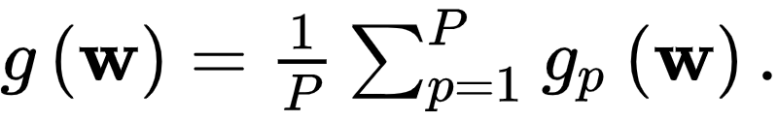
We can then form the Softmax cost for logistic regression by taking an average of these Log Error costs as
As with the Cross Entropy cost it is far more common to express the Softmax cost differently by re-writing the Log Error in a equivalent way as follows.

Slide 24
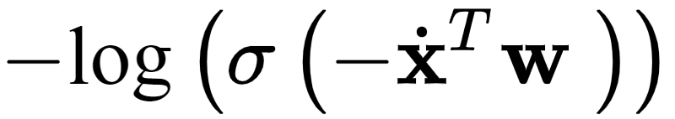
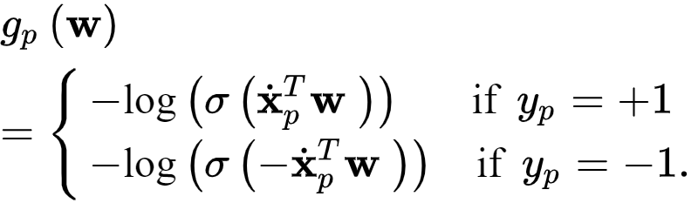
First notice that because
The second case in the point-wise cost above can be re-written equivalently as and so the point-wise cost function can be written as

Slide 25
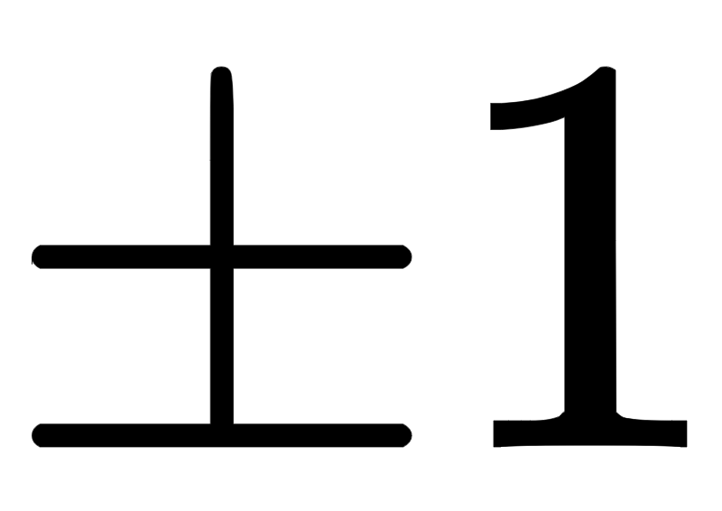

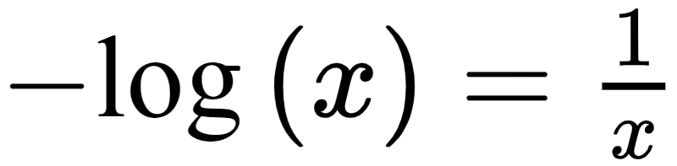
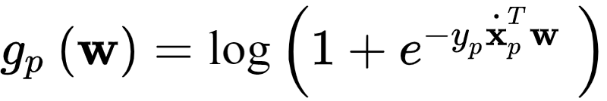
Now notice that because we are using the label values we can move the label value in each case inside the inner most paraenthesis, and we can write both cases in a single line as
Finally since the negative log property states that we can re-write the point-wise cost above equivalently (using the definition of the sigmoid) as

Slide 26
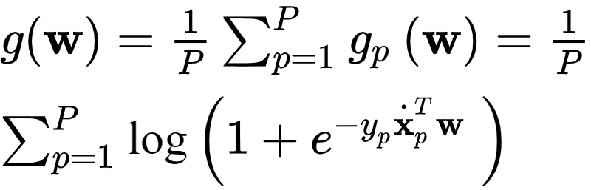
Taking the average of this point-wise cost over all P points we have a more common appearance of the Softmax cost for logistic regression
This cost function, like the Cross Entropy cost detailed in the previous Section, is always convex regardless of the dataset used.

Slide 27
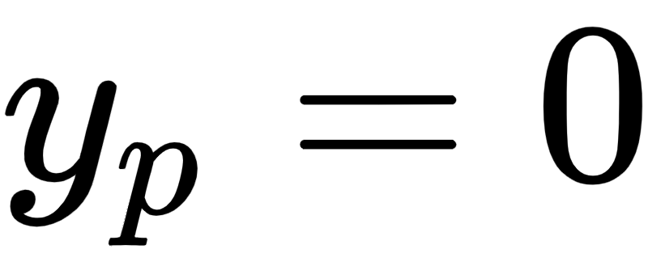
Moreover, as we can see here by its derivation, the Softmax and Cross Entropy cost functions are completely equivalent (upon change of label value to and vice-versa) having been built using the same point-wise cost function.

Slide 28
Implementing and minimizing a modular Softmax cost in `Python`

Slide 29
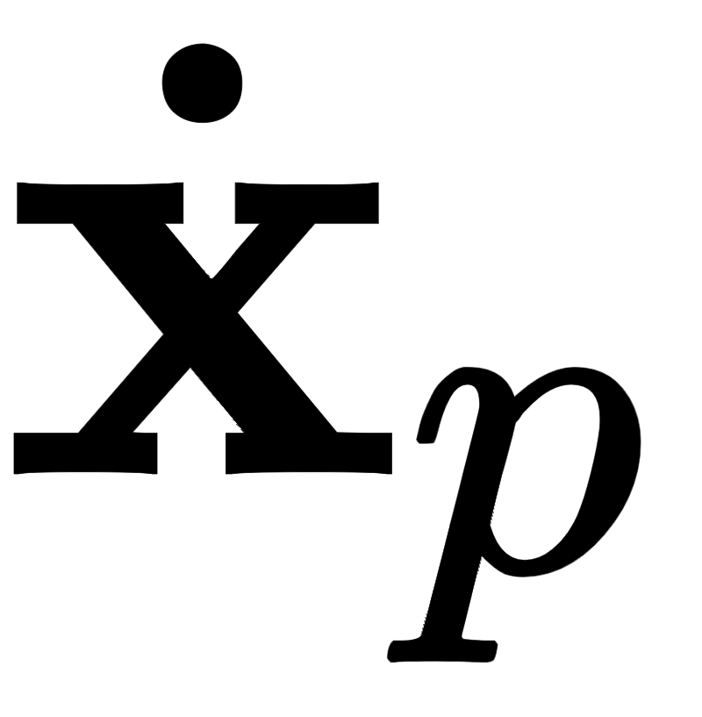
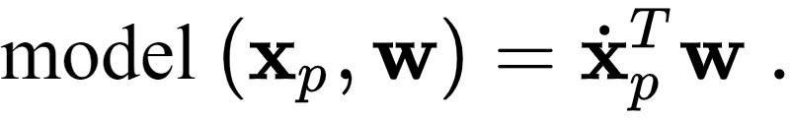
We can implement the Softmax costs very similarly to the way we did the Least Squares cost for linear regression.
Our linear `model` takes in both an appended input point and a set of weights

Slide 30

With this notation for our model, the corresponding Softmax cost is
We can then implement the cost in chunks - first the `model` function below precisely as we did with linear regression.

Slide 31
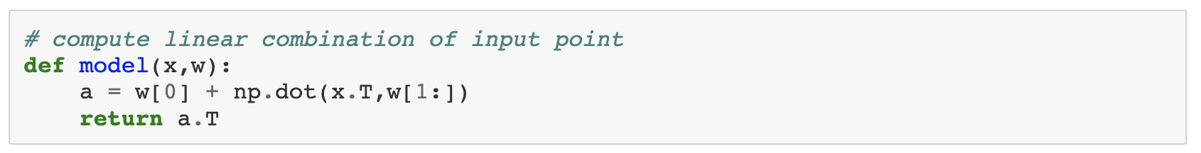

Slide 32
Note here that the implementation differs slightly from the algebraic form of the linear `model`, taking in the original input and forming the compact version (stacking a 1 atop each input) once inside (as was first explained in [Section 5.2].
Using the Log Error costs we can then implement the Softmax - employing efficient and compact `numpy` operations - as

Slide 33
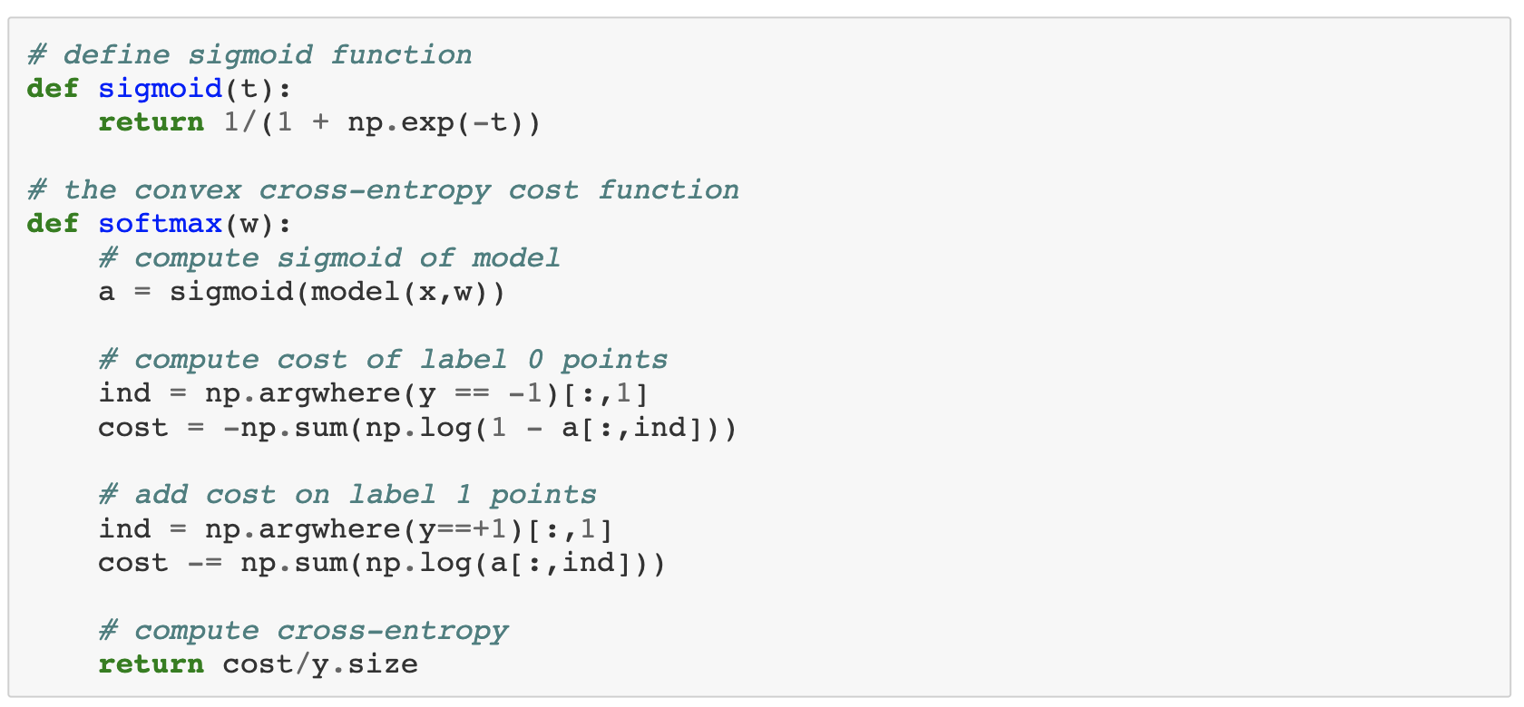

Slide 34
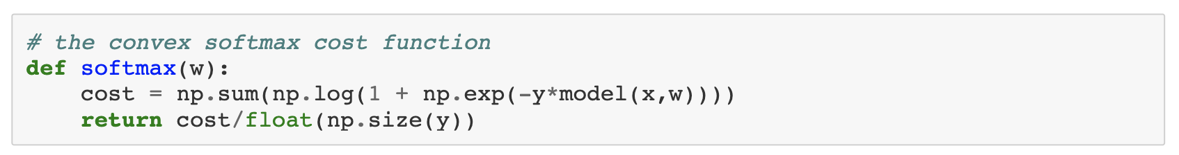

Slide 35
The Softmax cost is always convex regardless of the dataset used.
A mathematical proof is provided in the appendix of this Section that verifies this claim more generally.
We displayed a particular instance of the cost surface in the right panel of Example 2 for the dataset first shown in Example 1.
Looking back at this surface plot we can see that it is indeed convex.

Slide 36
Since the Softmax cost function is convex a variety of local optimization schemes can be used to properly minimize it properly.
For these reasons the Softmax cost is used more often in practice for logistic regression than is the logistic Least Squares cost for linear classification.

Slide 37
Example: Using gradient descent to perform logistic regression using the Softmax cost

Slide 38
In this example we repeat the experiments of Example 2 of the previous Section - swapping out labels with - using the Softmax cost and gradient descent.
Below we show the result of running gradient descent with the same initial point and fixed steplength parameter for 2000 iterations, which results in a better fit.

Slide 39
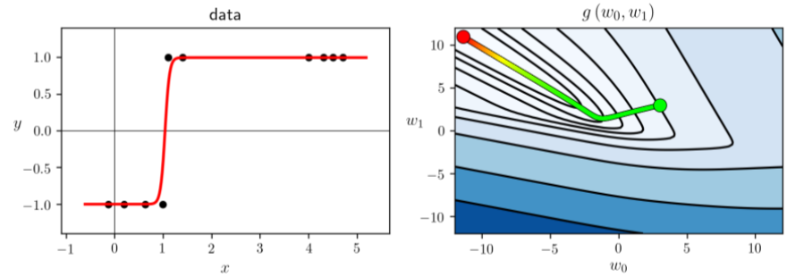

Slide 40
'Noisy' datasets

Slide 41
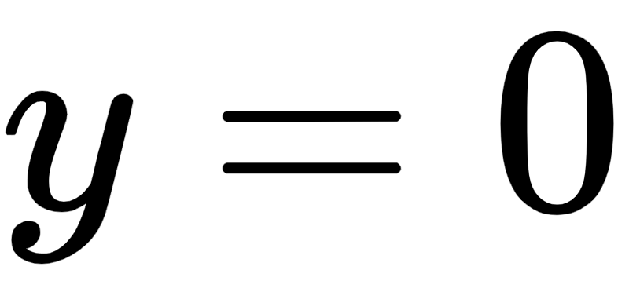
Below we show a multi-input ( ) dataset of 100 points.
Here the two classes cannot be perfectly separated by any line.
In the left panel we show the data in three dimensions, and in the right panel we show the data as viewed 'from above'.
'from above' means we're looking down from a point high up on the y axis (or in other words, the data projected onto the plane ).

Slide 42
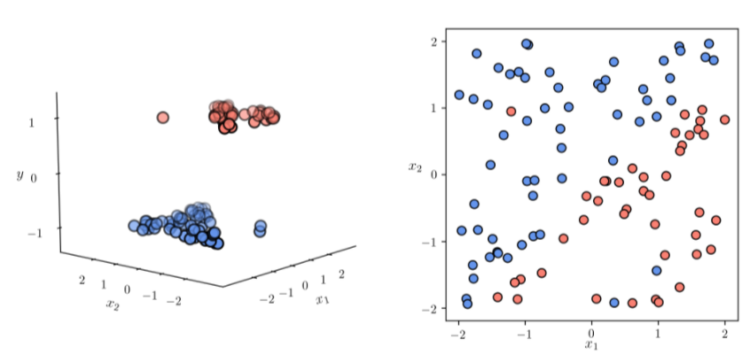

Slide 43
Other than these 'noisy' points the two classes look like they can be very well fit with our nonlinear regressor.
In the classification context a 'noisy' point is one that has an incorrect label.
Such points are often misclassified by a trained classifier, meaning that their true label value will not be correctly predicted.
Two class classification datasets typically have noise of this kind and are not often perfectly separable by a hyperplane.

Slide 44
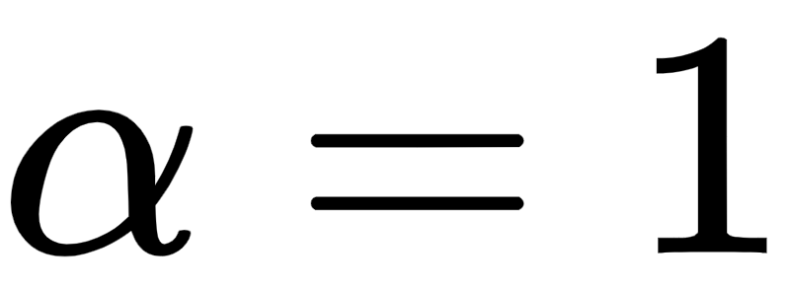
Even with the presence of noise we can still find the best parameters of a linear decision boundary for a dataset like this by minimizing the Softmax cost.
In the next ``Python`` cell we run 100 steps of gradient descent with a random initialization and fixed steplenth to minimize the Softmax cost on this dataset.
To ensure this is a proper steplength value we check the cost function history plot below.

Slide 45
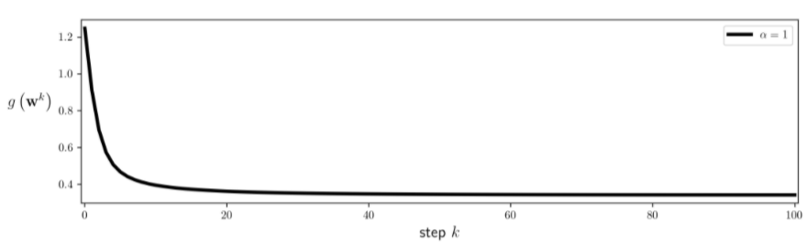

Slide 46
